Slide 1
Teaching System Design to Undergrads
Leon McGinnis
Professor Emeritus
Stewart School of Industrial and Systems Engineering
Georgia Tech
Notes:
At ASU, September 11, 2014

Slide 2
Your turn

Slide 3
How can we teach “applied” courses if we’ve never been in practice?
Inventory, production planning, logistics, manufacturing systems, …
We teach principles, methods and tools
We can do the same thing for system design
So what are those principles, methods, and tools?

Slide 4
System Design Problem Example
Pick any CICMHE design competition case!
I’ll use the most recent one in this presentation—Fast Foods Now—an abridged version of which was emailed to you on Sunday

Slide 5
Fast Foods Now
Warehousing Scenario
  SKU master
  Order data
  Description of goods flow, storage constraints, growth projections, etc
Requirement: design a new warehouse
  Channel
  Storage systems
  Picking technology
This is a very typical “IE” systems design problem.

Slide 6
Engineering design of systems requires answering the following questions (not in a single sequence!):
What is the context for this system?
  How does this system create value?
What functions must this system provide/perform?
How can we best organize these functions into an architecture?
What technologies should we choose to enable these functions?
How shall we size and configure the technologies?
What shall be the final embodiment of the system?
How will we judge whether or not this system is a good system?
As we will see, there usually is some iteration involved!

Slide 7
Theme for today: How can we help students learn to answer these questions?

Slide 8
Some “axioms”:
What you can learn depends a lot on what you already know
For these questions, there may be lots of answers, both good and bad
Answering these questions well and quickly requires knowledge, experience, methods and tools
Discernment is not learned passively
The novice system designer needs a process to follow
The expert system designer may use a different process
This is an “interactive” session!

Slide 9
Decision Process (a “methodology”)
Context identified
Flows identified
Functions identified
Architecture specified
Technology selected, sized, configured
Solution evaluated
Iteration

Slide 10
Value-Driven Framework for System Design
Price
System Performance
Customer Demand
System Design Decisions
?
Revenue
System Costs
Profit
Notes:
Customers don’t care about your costs, only about your price and performance
This framework can be adapted to non-profit scenarios, by identifying what the design decision maker values
We can focus on a point in time, or on a time series and use discounting
Pedagogy: How and when should this framework be introduced? Do the students need some context first? Or can the concept be introduced and then the context developed to justify the framework?

Slide 11
System Design Process
Starts by identifying functions
Ends by specifying:
  Processes performed to transform input products to output products
    Production processes are “make” processes identified in the design of the product
    Logistics processes are the move and store/retrieve processes necessary to enable the production processes
  Resources that will execute processes
    The behaviors these resources must be capable of exhibiting
  Facility
    How the resources will be organized

Slide 12
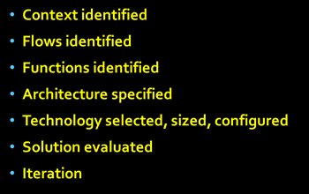
Context
Take 5 minutes to answer these two questions.
  What is in the context for this design problem?
  What is out of scope?
Focus on:
  What is “flowing”?
  Who/what are the “actors”?
  What do the actors “do”?

Slide 13
As-Is Scenario
(magnitudes of total annual flows, by SKU)
Direct
Uncertainty: demand, supply, growth
Cross-Dock
Suppliers
Customers (Restaurants)
Inventory
(“many?”)
(200)
(size, operating characteristics)
Within limits, FFN can choose which channels are appropriate for each SKU

Slide 14
In Scope
How to select channel for each SKU
How to set inventory policy for SKUs in inventory
Seasonality
How to integrate operations of cross-dock and order-picking operations spread across two distinct warehouse facilities
Selection, sizing and configuration of storage technologies
Selection of order-picking method(s)

Slide 15
Out of Scope
WMS
Yard management
Outbound truck loading
Routing deliveries to restaurants

Slide 16

As seen by students with no experience, thus no starting point for understanding

Slide 17
How Can We Help Them?
System semantics:
  P/P/R/F and structure/behavior/control and function
Domain semantics
  Supplier, Customer, Flow, Unit of Handling, Channel
Domain Processes
  Transportation, Cross-Docking, Receiving, Inventory, Shipping
Principles
  Conservation of flow—over some time interval!
  Uncertainty
Use the as-is scenario as the platform for introducing the domain knowledge

Slide 18
System Semantics (1)
Product: what is flowing
Process: how the flow is transformed
Resource: that which executes the transformation
Facility: the organization of resources through which the product flows
These can be directly observed in any particular system domain, any application domain.

Slide 19
System Semantics (2)
Structure: the set of resources and how they are connected (this determines what flows are possible)
Behavior: a resource’s possible behaviors are described by the kinds of processes it is capable of performing
Control: determines which resources perform which processes on a unit of flow and the sequence of processes executed by a resource

Slide 20
System Semantics (3)
Function
  An abstraction of process, with no specific associated product or resource
  Describes a type of process that might be applied to a type of product using some type of resource
Examples:
  In warehousing, we can speak of an inbound function without identifying a specific warehouse, specific products, specific processes or specific resources
  In healthcare delivery, we can speak of triage without identifying a specific scenario
  In manufacturing, we can speak of work in process buffer without identifying a specific product

Slide 21
To-Be Scenario
Direct
Cross-Dock
Suppliers
Customers (Restaurants)
Inventory
(“many?”)
(>200)
Inventory
Designed solution must accommodate growth

Slide 22
How might we identify the “best” warehouse design for FFN?
Minimize the cost to meet a service level of (1-α)100%.
Cost
Service Level

Slide 23
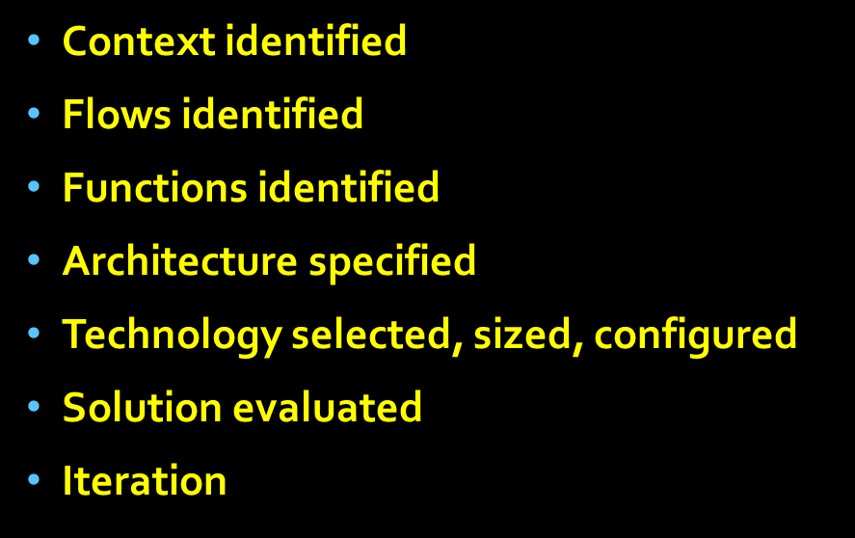
What System Functions Are Essential for Creating Value?
Follow one particular SKU through the warehouse channel and record every process executed by a resource
Imagine you have a GoPro camera on a customer shippable unit
It comes in on a full pallet
It goes out in a mixed pallet
What happens in between?
Take a few minutes to sketch out your answer
Notes:
Focus on the warehoused channel to illustrate the principles, which can be applied to the other channels with appropriate changes.

Slide 24
Every SKU in the FFN warehouse flow sees the following processes
Unload from truck
Receive/stage
Move to storage location
(pick pallet from reserve and move to forward location)
Case/each pick from forward location
Case/each assemble to customer order
Customer order packed
Customer order moved to shipping/staged
Customer order loaded to delivery vehicle
Notes:
This is a good description, but unfortunately, it is a description of a completed “design” and thus not very useful for developing the design. We need to back up to a more generic description

Slide 25
We can generalize this specific flow to describe the generic warehouse functions
Complete Customer Order
As-Ordered SKU
Inbound Function
Order Assembly Function
Outbound Function
Inbound Carrier
As-Delivered SKU
As-Shipped Customer Order
Outbound Carrier
Notes:
Key points in this picture:
What comes in is individual SKU’s, which go into inventory
What comes out is customer orders
The order assembly functions transforms inventory into customer orders

Slide 26
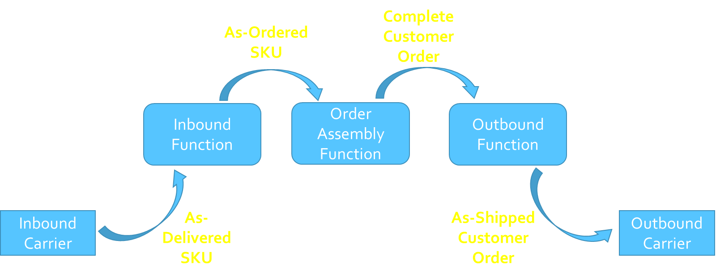
For FFN
Inbound Function “disassembles” carrier loads, receives SKUs, stages SKUs for putaway, and gets SKUs to the locations from which they will be retrieved by the Order Assembly Function
Order Assembly is, in fact, a “manufacturing” process—it takes “order parts” from inventory and assembles them into a customer order
Outbound Function prepares customer orders for shipment, and stages them for pickup/loading by carriers
As-delivered and as-ordered are almost always different:
  Pallets to cases, cases to eaches
  What flows into Order Assembly is quite different from what flows out

Slide 27
Observations
These functions are quite well-defined, both in terms of flows and in terms of “interfaces”
We can design each function independently, provided we have a clear definition of its interfaces and flows
  But they still have to be integrated!
The design process is almost certainly iterative
Of course, we could try to intuit a “grand design” all at once! (Not a good idea, especially for novices…)

Slide 28
Elaborating the Inbound Function
Inbound Function
Carrier
Receive
Move
Store
Move
Store
Order Assembly
Quantify movement and storage requirements
Quantify arrival rate, service time for delivering vehicles
Notes:
The inbound function can be decomposed further into a set of functions that are related by the linear flow of goods from the receiving dock to the inventory location from which goods are removed to form customer orders.

Slide 29
Requirements for movement and storage are dictated by inbound flows
In FFN, there are nearly 6000 active SKUs, and we can’t design a different system for each one!
We need to identify SKU families, with the intention that every SKU in a SKU family will be treated exactly the same way in the inbound function
Why would we treat two SKUs exactly the same way—what makes them “similar”?
Let’s look at the FFN data…

Slide 30
Similarities
Channel (direct, cross-dock, warehouse) but…
Storage requirement (ambient, cool, chilled)
Usage rate (units per week, e.g.)
Usage per order
Size (cube, weight)
Resupply leadtime
Other?
Any consideration impacting how goods are stored or moved

Slide 31
SKU Profiling Analysis
Dale Masel’s unit in the CICMHE
Textbooks and other sources
Pivot tables in Excel
Tableau
Intuition!
Notes:
Clearly, defining the SKU families is a design decision, and there are many analytic tools that can support this decision.

Slide 32
Reality Check
The data is !@#$, usually
This is especially hard for students to deal with, so you need to be prepared to provide a lot of support
Develop some general guidelines to give, when asked specific questions
Let’s look at the FFN case data

Slide 33
Data “Issues”
Mixed numbers and text (impacts Excel operations)
Delete the “zero usage” SKUs, 38000->5700 relevant SKUs
Nonsensical values:
  3 poultry SKUs account for nearly 150 million pounds shipped, roughly 3700 reefers!
1678 SKUs rec’d in warehouse, but only 1376 shipped…
Total in not close to total out…
Undocumented “units of measure” … argh!
Etc….
You have to decide how to deal with these data anomalies, i.e., what data will you use to drive your design?

Slide 34
Input Families
Input Families:
DrystockCase: 671 SKUs; e.g., pallet rack, forward at floor level
ConditionedEach: 473 SKUs (36 Drystock/EA, 92 Alcohol/Case and 345 EA-Alcohol or Choc/Tea; e.g., pallet rack, forward at floor level
Perishable: 232 SKUs, all P, 202 CA, 2 EA, 28 LB; e.g., pallet rack forward at floor level

Slide 35
Elaborating the Inbound Function
Receive
Move
Store
Move
Store
Carrier
Receive
Move
Store
Move
Store
Order Assembly
Drystock CA
ConditionedEA
Move
Store
Move
Store
Perrishable
Move
Store
Move
Store
List of “functions”:
Receive
6 Moves
3 Stores
NOTE:
I can come back later and change the families, or change the functions or change how I group functions.
Notes:
Note that I haven’t said anything about HOW these functions are performed!

Slide 36
What we need to specify for each function
For each Move function:
  The number or rate of move transactions
  The properties of the move transactions (weight, volume, etc)
For each Store function:
  The number or rate of store/retrieve transactions
  The storage capacity
  The properties of the storage (constraints to be satisfied)

Slide 37
Data Limitations
We only have totals by month, no information about actual received shipments.
So, the design team has to make some reasonable assumptions
In this case, what might be some reasonable assumptions?

Slide 38
Elaborating the Outbound Function
We don’t have much to go on here…
Assume orders take two forms: full/partial pallet, or one or more cases. Assume that both kinds of orders are moved in the same way from Order Ass’y to Pack/Ship, and then to Stage/Load
Outbound Function
Four functions:
Move
Pack/Ship Pallet
Pack/Ship Case
Stage/Load
Order Assembly
Move
Pack/ShipPallet
Move
Stage/
Load
Outbound Carrier
Pack/Ship Case
Unfortunately, for this case problem, we don’t have detailed information about daily shipments, so we’ll have to make some assumptions. What kinds of assumptions would be reasonable, given the overall scenario?

Slide 39
What we need to specify for each function
For each Move function:
  The number or rate of move transactions
  The properties of the move transactions (weight, volume, etc)
For Pack/Ship:
  The rate at which orders are packed/shipped and the characteristics of orders (needed to estimate resource requirements)
For Stage/Load
  The arrival rate of orders to load, the arrival rate of carrier vehicles (queuing related properties)

Slide 40
Data Limitations
We only have totals by month, no information about actual customer shipments.
So, the design team has to make some reasonable assumptions
In this case, what might be some reasonable assumptions?

Slide 41
Some Really Important Observations
The InBound and OutBound functions are “linear flows”
The implementation of these functions is, more or less, independent of the “control” decisions involved, such as putaway location or dock door assignment
We can at least think about, and often specify, the resources needed to embody these functions first, and then worry about the associated control systems later
This makes InBound and OutBound quite different from Order Assembly!

Slide 42
Elaborating the Order Assembly Function
(this is where all the magic occurs!)
Order Assembly Function
Inbound Function
Retrieve Order Part
Outbound Function
Move Order Part
Accumulate Order Parts
Move Order
Order assembly does not decompose nicely into a linear functional flow. It’s a system, and has to be thought of that way.

Slide 43
What can we infer from the data?
Rates of “order parts” retrieval
  Eaches, cases, pallet retrieval rates
Rates of accumulation
  Relative frequencies of lines per order
  Accumulation composition
    Mix of each, case, pallet
Rates of “move” really depends on the specific system selected

Slide 44
FFN Order Assembly Data
Don’t have actual customer order data
Have to make some assumptions
What assumptions seem reasonable?

Slide 45
“Process Check”
Take-aways
  Semantics
  Identify flows
  Identify functions
  Identify flow families
Next
  Architecture
System “Requirements” Decision
System Design Decision

Slide 46
Architecture
Basic idea is to aggregate functions into subsystems.
Examples:
  Architecture of an automobile: frame, body, drive train, cabin
  Architecture of an airplane: wing, fuselage, propulsion
Motivation: break the design problem up into “homogeneous” pieces that can be worked on independently, but integrated

Slide 47
How do you make these “architectural” decisions?
You have to know that the functions can, in fact, be performed by a single system.
  In an automobile, you wouldn’t combine a “provide rotational power” and “provide communication access” functions
You probably use some prior knowledge of the kinds of technologies that can be used for the individual functions
I.e., it’s not a random assignment!
An opportunity to introduce material handling equipment and systems…

Slide 48
Inbound Functional Architecture
Receive
Move
Store
Move
Store
Carrier
Receive
Move
Store
Move
Store
Order Assembly
Drystock CA
ConditionedEA
Move
Store
Move
Store
Perrishable
Move
Store
Move
Store
All move functions combined into one system (maybe lift trucks of some sort).
For each flow family, a single store system for both reserve and forward/pick
Five subsystems to design: receiving, moving, and three storage systems.
Notes:
Note that I haven’t said anything about HOW these functions are performed!

Slide 49
Outbound Functional Architecture
Outbound Function
Order Assembly
Move
Pack/ShipPallet
Move
Stage/
Load
Outbound Carrier
Pack/Ship Case
One move subsystem, two pack/ship subsystems, and one stage/load subsystem

Slide 50
Order Assembly Functional Architecture
Order Assembly Function
Inbound Function
Retrieve Order Part
Outbound Function
Move Order Part
Accumulate Order Parts
Move Order
Order assembly does not decompose nicely into a linear functional flow. It’s a system, and has to be thought of that way—one system that performs all four functions.

Slide 51
Selecting Technologies
Each subsystem has well-defined input and output requirements
Each potential technology has well-defined capabilities (processes that it can execute)
Selecting technology is a matter of matching requirements and capabilities
There can be many feasible combinations, and evaluating each one can be time consuming, because you have to size and configure the technology in order to assess its performance and cost
You want some guidelines for identifying “promising” technologies

Slide 52
So, how does the designer choose?
Use knowledge and judgement to reduce the set of candidates.
There are many resources that can be useful, see .e.g.,
http://www.mhi.org/downloads/learning/cicmhe/colloquium/2010/apple.pdf
and many other sources accessible through google

Slide 53
Suppose the technology selections are:
Inbound
  Lift trucks, pallet rack
Order Assembly
  Single order pick to pallet using lift trucks
Outbound
  Lift truck, accumulate case orders to move to Stage/Load
Note: there some pretty obvious variations of these decisions which should also be examined…

Slide 54
Each subsystem has to be sized and configured
Inbound
  Number of dock doors, space for staging
  Storage:
    Capacity from inventory analysis
    Tiers, aisles
  Lift trucks:
    Number based on move rate and distance travelled
      How to incorporate reserve-to-forward moves?
      Queuing type analyses
Here, you can introduce many different kinds of analyses to support the sizing and configuring

Slide 55
Each subsystem has to be sized and configured
Order Assembly
  Number of order pickers
    Depends a great deal upon
      Where SKUs are located in storage
      How pickers are routed, e.g., to minimize in-the-aisle conflicts
Outbound
  Number of pack/ship stations and staging for each
  Size of Stage/Load area
Here, you can introduce many different kinds of analyses to support the sizing and configuring

Slide 56
Sizing and configuring is mostly analysis, not decision-making!
There are many, many sources of analysis models that can be used.

Slide 57
System Evaluation
Evaluating the system may not be as simple as “adding up” the evaluations of each subsystem
  How do the subsystems interact?
  Do the interactions have any impact on performance?
May do some “tweaking” of the design to improve the system evaluation.

Slide 58
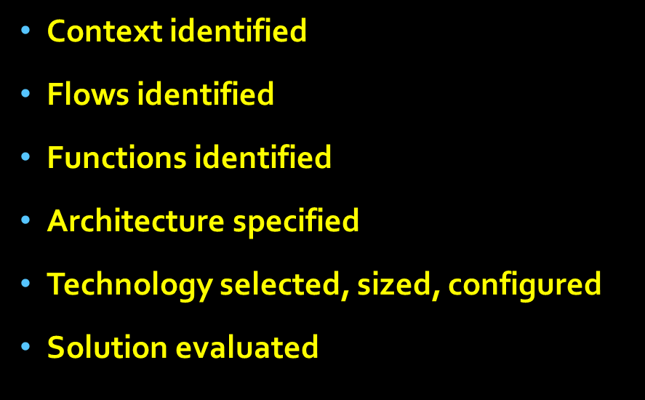
Iteration in System Design
At any point in the process, the designer can go back to change a previous decision!

Slide 59
Analysis to Support Design
Decision Making
Inventory modeling to assess the storage capacity required
Analysis models to configure, e.g., for a given “shape factor”
Once a storage system has been “sized” and “configured” and then analysis can estimate the travel time for putaway and for replenishing forward pick locations.
For many picker-to-goods systems, there are analytic models of picker performance
Of course, simulation …

Slide 60
Principles
Deciding how to deal with the data is a design decision!
Specifying SKU and Order families, functions, architecture, and selecting technologies are design decisions
Sizing and configuring is a design decision, but it often can be done algorithmically—optimizing some performance attribute
SKUs are inventory as long as they are in the InBound Function
SKUs in Order Assembly are order parts

Slide 61
CICMHE design competition cases are a great way to teach design principles, and students generally are much more engaged with design cases than with traditional lecture.
Just do it!

Slide 62
To the MHTI 2017 participants, to David Porter, to CICMHE, and to the many colleagues who have influenced my thinking about design,
Thank you!

Slide 63
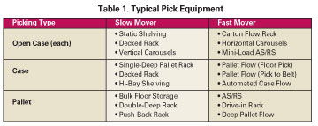
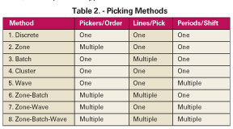
There are many options…these are picker-to-goods
Assumes picker following route through storage system.
Alternative ways to organize the picking operations.
http://www.scdigest.com/assets/newsviews/05-09-01-3.cfm?cid=220

Slide 64
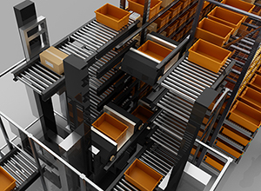
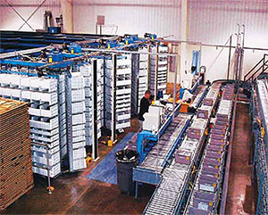
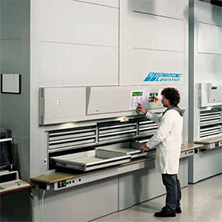
But there are many systems that bring goods to the picker
http://kuecker.com/automated_picking_solutions

Slide 65
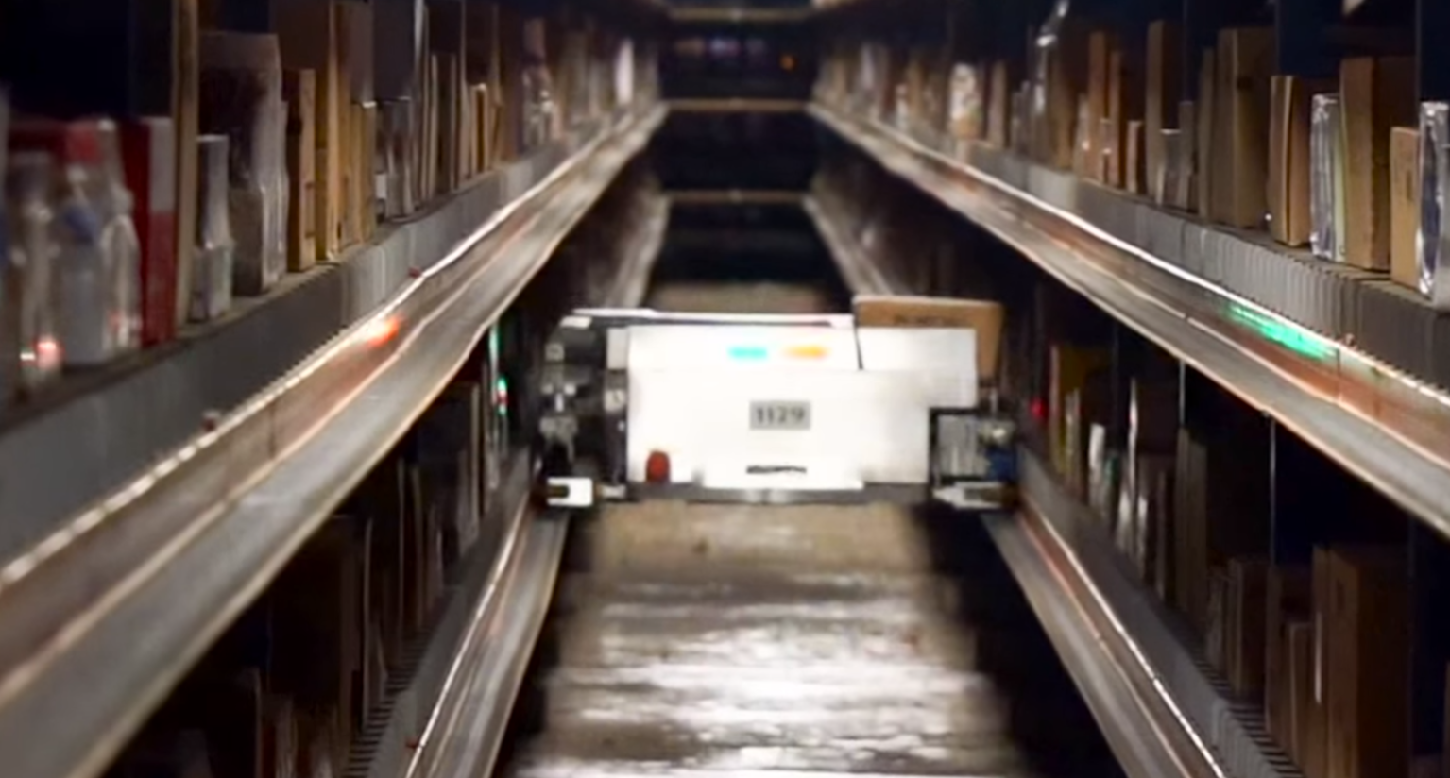
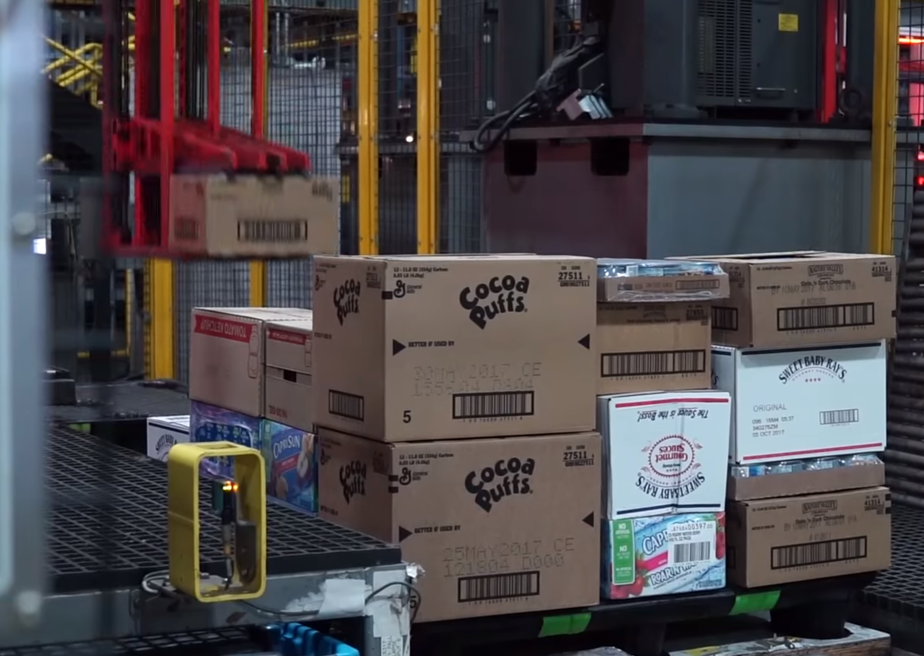
Even fully automated case picking

